Slide 1
Packages and Interfaces
Notes:
‹#›

Slide 2
packages are container for classes.
used to keep the class name compartmentalized.
package is both a naming and visibility control mechanism.

Slide 3
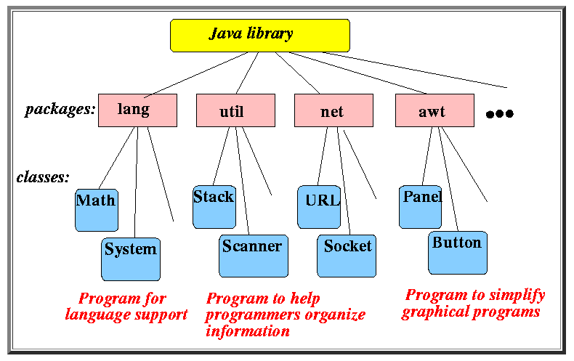
C:\Program Files (x86)\Java\jdk1.8.0_101\jre\lib\rt\java

Slide 4
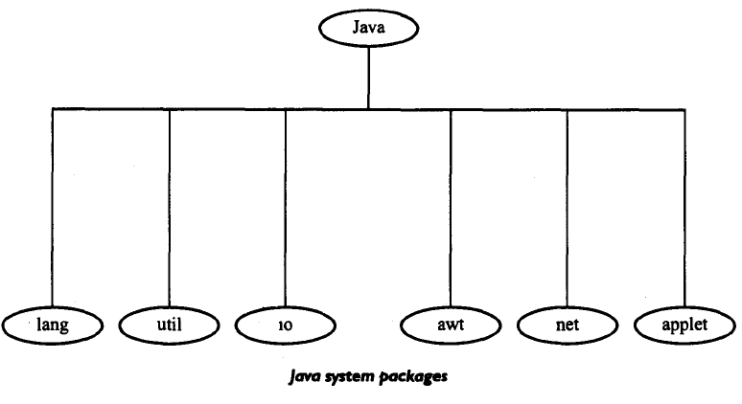

Slide 5
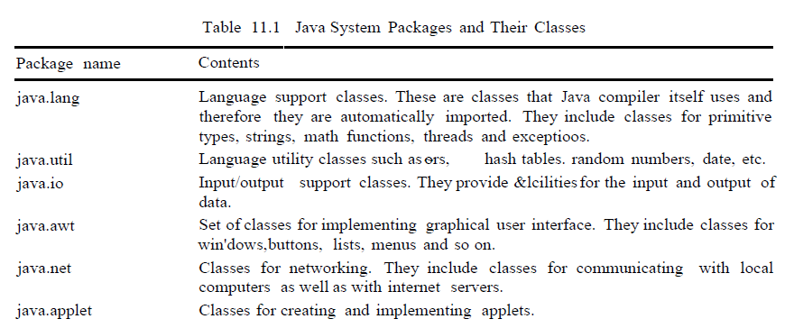

Slide 6
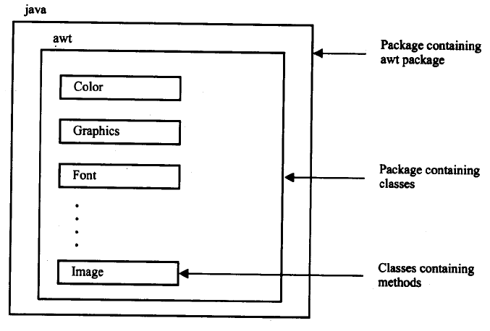

Slide 7


Slide 8


Slide 9


Slide 10


Slide 11
Defining a package
To create a package include a package command as the first statement.
Any classes declared within that file will belong to the specified package.
If package statement is not included, then class names are put into the default package, which has no name.

Slide 12
General form :
package pkg;
Ex: package MyPackage;
We can create a hierarchy of package.
General form
package pkg1[.pkg2[.pkg3]];
Ex: package java.awt.image.

Slide 13
Finding packages and CLASSPATH
First, by default, the Java run-time system uses the current working directory as its starting point.
if our package is in the current directory, or a subdirectory of the current directory, it will be found.
Second, we can specify a directory path or paths by setting the CLASSPATH environmental variable.
We can use –classpath option with java and javac to specify the path to our class.

Slide 14
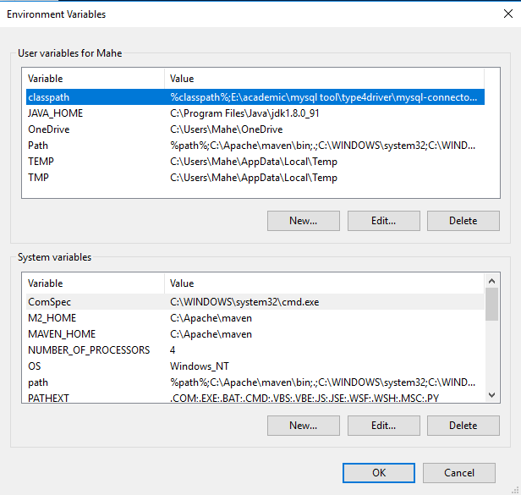
Finding packages and CLASSPATH

Slide 15
Example
Consider the following package specification.
package MyPack;
In order for a program to find MyPack, one of the 3 things must be true.
Either the program is executed from a directory immediately above MyPack.
CLASSPATH must be set to include the path to MyPack.
The –classpath option must specify the path to MyPack when the program is run via java.

Slide 16
When second two options are used, the classpath must not include MyPack itself.
It must specify the path to MyPack.
For ex: in windows if the path is to MyPack is
C:\MyPrograms\java\MyPack
Then the classpath to MyPack is
C:\MyPrograms\java

Slide 17
A Short Package Example
package MyPack;
class prg
{
public static void main(String args[])
{
System.out.println(“first program to illustrate package”);
}
}
Name the above file as prg.java and put it in a directory called MyPack.
Next compile the file, make sure that resulting class file is also in MyPack.
Run the program using
java MyPack.prg

Slide 18
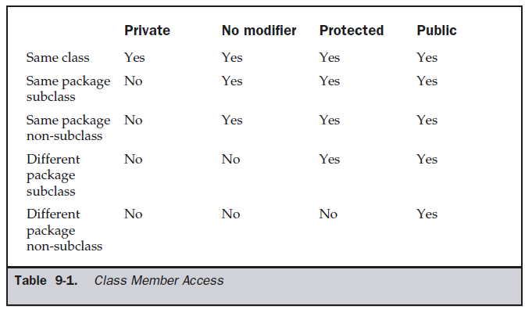
Access Protection

Slide 19
Example has two packages p1 , p2 and five classes.
first package defines three classes: Protection, Derived and SamePackage.
The first class defines four int variables in each of the legal protection modes.
The variable n is declared with the default protection, n_pri is private, n_pro is protected, and n_pub is public.

Slide 20
The second class, Derived, is a subclass of Protection in the same package p1.
This grants Derived access to every variable in Protection except for n_pri.
The third class, SamePackage, is not a subclass of Protection, but is in the same package and also has access to all but n_pri.

Slide 21
package p1
class protection
{
}
class derived extends protection
{
}
class samepackage
{
}
package p2
class derived2 extends p1.protection
{
}
class otherpackage
{
}

Slide 22
Protection.java
package p1;
public class Protection
{
int n = 1;
private int n_pri = 2;
protected int n_pro = 3;
public int n_pub = 4;
public Protection()
{
System.out.println("n = " + n);
System.out.println("n_pri = " + n_pri);
System.out.println("n_pro = " + n_pro);
System.out.println("n_pub = " + n_pub);
}
}

Slide 23
Derived.java
package p1;
class Derived extends Protection
{
Derived()
{
System.out.println("n = " + n);
// System.out.println("n_pri = " + n_pri);
System.out.println("n_pro = " + n_pro);
System.out.println("n_pub = " + n_pub);
}
}

Slide 24
SamePackage.java
package p1;
class SamePackage
{
SamePackage()
{
Protection p = new Protection();
System.out.println("n = " + p.n);
// System.out.println("n_pri = " + p.n_pri);
System.out.println("n_pro = " + p.n_pro);
System.out.println("n_pub = " + p.n_pub);
}
}

Slide 25
Protection2.java
package p2;
class derived2 extends p1.Protection
{
Protection2()
{
// System.out.println("n = " + n);
// System.out.println("n_pri = " + n_pri);
System.out.println("n_pro = " + n_pro);
System.out.println("n_pub = " + n_pub);
}
}

Slide 26
OtherPackage.java
package p2;
class OtherPackage
{
OtherPackage()
{
p1.Protection p = new p1.Protection();
// System.out.println("n = " + p.n);
// System.out.println("n_pri = " + p.n_pri);
// System.out.println("n_pro = " + p.n_pro);
System.out.println("n_pub = " + p.n_pub);
}
}

Slide 27
Importing Packages
import statement to bring certain classes, or entire packages, into visibility.
Once imported, a class can be referred to directly, using only its name.
This is the general form of the import statement:
import pkg1[.pkg2].(classname|*);
import java.util.Date;
import java.io.*;
import java.awt.*;
import statements occur immediately following the package statement (if it exists) and before
any class definitions.

Slide 28
All of the standard Java classes included with Java are stored in a package called java.
The basic language functions are stored in a package inside of the java package called
java.lang.
We have to import every package or class that we want to use, but since Java is useless
without much of the functionality in java.lang, it is implicitly imported by the compiler for all
programs.
This is equivalent to the following line being at the top of all of our programs:
import java.lang.*;

Slide 29
import statement is optional.
import java.util.*;
class MyDate extends Date
{
}
The same example without the import statement looks like this:
class MyDate extends java.util.Date
{
}

Slide 31
import org.cloudbus.cloudsim.Datacenter;
import org.cloudbus.cloudsim.DatacenterBroker;
import org.cloudbus.cloudsim.Host;
import org.cloudbus.cloudsim.Storage;
import org.cloudbus.cloudsim.Vm;
class prg
{
public static void main(String args[])
{
Host h = new Host();
Vm v = new Vm();
}
}

Slide 32
Interface

Slide 33
An interface is basically a kind of class.
Like classes, interfaces contains methods and variables.
Difference : interfaces define only abstract methods and final variables.
Interface do not specify any code to implement the methods.
Interfaces are designed to support dynamic method resolution at runtime.

Slide 34
Defining an interface
access interface name
{
return-type method-name1(parameter-list);
…………….
return-type method-nameN(parameter-list);
type final-varname1 = value;
…………….
type final-varnameN = value;
}
Methods are declared with no bodies.
All variables are implicitly final and static.

Slide 35
interface interfacename
{
variable declaration
method declaration
}
Example:
interface item
{
static final int code=1000;
void display();
}

Slide 36
Example
interface Callback
{
void callback(int param);
}

Slide 37
Implementing Interfaces
access class classname [extends superclass] [implements interface [,interface...]]
{
// class-body
}

Slide 38
class Client implements Callback
{
public void callback(int p)
{
System.out.println("callback called with " + p);
}
}
When we implement an interface method, it must be declared as public.

Slide 39
We can also define additional members.
class Client implements Callback
{
public void callback(int p)
{
System.out.println("callback called with " + p);
}
void nonIfaceMeth()
{
System.out.println(“Added method");
}
}

Slide 40
Accessing Implementations Through Interface References
class TestIface
{
public static void main(String args[])
{
Callback c = new Client();
c.callback(42);
}
}
c can be used to access the callback() method, it can not access any other members of the Client class.

Slide 41
// Another implementation of Callback.
class AnotherClient implements Callback
{
public void callback(int p)
{
System.out.println("Another version of callback“+(p+10));
}
}

Slide 42
class TestIface2
{
public static void main(String args[])
{
Callback c = new Client();
AnotherClient ob = new AnotherClient();
c.callback(42);
c = ob; // c now refers to AnotherClient object
c.callback(42);
}
}
OUTPUT: callback called with 42
another version of callback 52.

Slide 43
Partial Implementations
If a class includes an interface but does not fully implement the methods defined by
that interface, then that class must be declared as abstract.
abstract class Incomplete implements Callback
{
int a, b;
void show()
{
System.out.println(a + " " + b);
}
// ...
}

Slide 44
Nested interface
An interface can be declared as member of a class or another interface. Such
interface is called a member interface.
Ex: class A
{
public interface prg
{
voud disp();
}
}

Slide 45
Nested interface
Interfaces (or classes) can have only public and default access specifiers when declared outside any other class.
This interface declared in a class can either be default, public, protected not private.
While implementing the interface, we mention the interface as c_name.i_name
Here c_name is the name of the class in which it is nested and i_name is the name of the interface itself

Slide 46
Nested interface
class Test
{
interface Yes
{ void show();
}
}
class Testing implements Test.Yes
{ public void show()
{ System.out.println("show method of interface");
}
}

Slide 47
Nested interface
class A
{
public static void main(String[] args)
{
Test.Yes obj;
Testing t = new Testing();
obj=t;
obj.show();
}
}

Slide 48
Applying Interfaces
// Define an integer stack interface.
interface IntStack
{
void push(int item); // store an item
int pop(); // retrieve an item
}

Slide 49
class FixedStack implements IntStack
{
private int stck[];
private int tos;
FixedStack(int size)
{ stck = new int[size];
tos = -1;
}
public void push(int item)
{ if(tos==stck.length-1) // use length member
System.out.println("Stack is full.");
else
stck[++tos] = item;
}

Slide 50
// Pop an item from the stack
public int pop()
{
if(tos < 0)
{ System.out.println("Stack underflow.");
return 0;
}
else
return stck[tos--];
}
}

Slide 51
class IFTest
{ public static void main(String args[])
{ FixedStack mystack1 = new FixedStack(5);
FixedStack mystack2 = new FixedStack(8);
for(int i=0; i<5; i++) mystack1.push(i);
for(int i=0; i<8; i++) mystack2.push(i);
System.out.println("Stack in mystack1:");
for(int i=0; i<5; i++)
System.out.println(mystack1.pop());
System.out.println("Stack in mystack2:");
for(int i=0; i<8; i++)
System.out.println(mystack2.pop());
}
}

Slide 52
Variables in Interfaces
We can use interfaces to import shared constants into multiple classes.
interface SharedConstants
{ int NO = 0;
int YES = 1;
int MAYBE = 2;
int LATER = 3;
}
Class A implements SharedConstants
{ int x;
A() { x=1; }
void fun()
{ if (x > 1 ) return NO; else return YES; }
}

Slide 53
Interfaces Can Be Extended
interface A
{
void meth1();
}
interface B extends A
{
void meth2();
}

Slide 54
// This class must implement all of A and B
class MyClass implements B
{
public void meth1()
{ System.out.println("Implement meth1().");
}
public void meth2()
{ System.out.println("Implement meth2().");
}
}

Slide 55
class prg
{ public static void main(String arg[])
{ MyClass ob = new MyClass();
ob.meth1();
ob.meth2();
}
}
Any class that implements an interface must implement all methods defined by that interface.

Slide 56
Create an interface Area with following method
void findArea(int, int);
Create a two class namely Rectangle and Triagle which implements Area interface.
Write a java program to find the area of rectangle and triangle.

Slide 57
interface Area
{
float findArea(int x, int y);
}
class Rectangle implements Area
{
public float findArea(int x, int y)
{
return (x*y);
}
}
class Triangle implements Area
{
public float findArea(int x, int y)
{
return (0.5*x*y);
}
}

Slide 58
class interfacePrg
{ public static void main(String args[])
{
Rectangle r = new Rectangle();
Triangle t = new Triangle();
Area a;
a= r;
System.out.println("Area of rectangle ="+a.findArea(10,20));
a= t;
System.out.println("Area of triangle ="+a.findArea(5,10));
}
}

Slide 59
Create an interface Vehicle with 2 methods
void numberOfSeats();
void numberOfWheel();
Create a two class namely car and bike which implements vehicle interface.

